Slide 1



I want to build matlab in python
I want to build R using NumPy

Slide 2
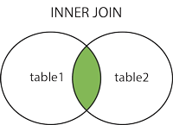
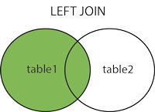
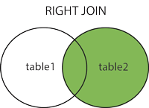
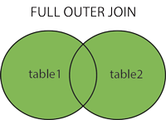

Slide 3


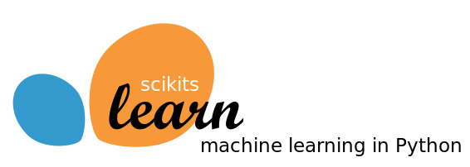

I want to be a product developer.
I’m rusty on stats and I want to learn how to analyze data.
I’m comfortable with stats and want to take over the world.

